Slide 1
Student profile management system
Using python,matplotlib and pandas
By Smit Adhikari, Krish Jung Thapa, Aisvaryam Katuwal

Slide 2
Project overview..
The project involves a basic functional Student Profile Management System developed in Python. It offers two primary user roles: Admin and Student login, where they can use their own system accordingly.
Admin can them store all the records of student, grades and ECA (extracurricular activities) and student can securely login to view their basic details, admission and their insights.
The project comprises of:
1.Secure login
2.Text file-based data storage
3.Modular and maintainable code
4.Console-based interaction

Slide 3
Purpose
This project aims to:
Normalize student record management.
Provide secure, role-based access with admins and students.
Offer an user-friendly view of their profiles for students.
Allow admins to add, edit and see the data for students.
Provide the insights of performance by the students in various activities.

Slide 4
Features
.
Secure Login system
.
Validates user credentials against stored data.
Role-Based Access Control
.
Admins and students both have different functionalities.
Student Features
.
.
View personal profile
View grades and ECA participation
Text File Storage
No database needed as
it uses .txt files to store
users, passwords, grades, and ECA data.
Admin Features
Add/edit student records
Manage grades and ECA
Generate reports using charts

Slide 5
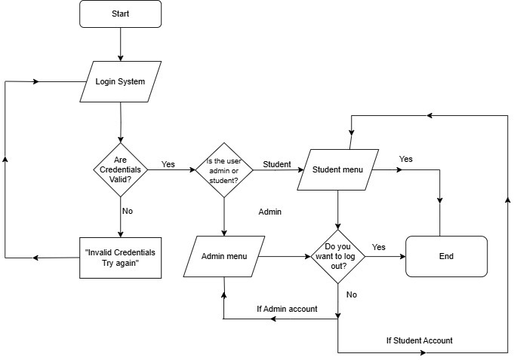
Flow Chart
.
The following flowchart explains the logic for the Student Management System:
Login systemthat checks user credentials
If the credentials are issued, the user is requested to make an attempt again.
If a user logins successfully, the system checks the role of user as:
They are then sent to the Student Menu if the user is a Student.
User is an Admin: Redirect to Admin Menu
Users may choose to log out of the system after their usage or return to their menu.
The loop would continue accordingly until the user logs out, thus terminating the program.
This process maintains secure login, role-based access and gated exit for both admin and student users. Logout Process Last but not least, the Logout Process comes along.
.
.
.
.
.
.
.
Flow chart describing the program

Slide 6
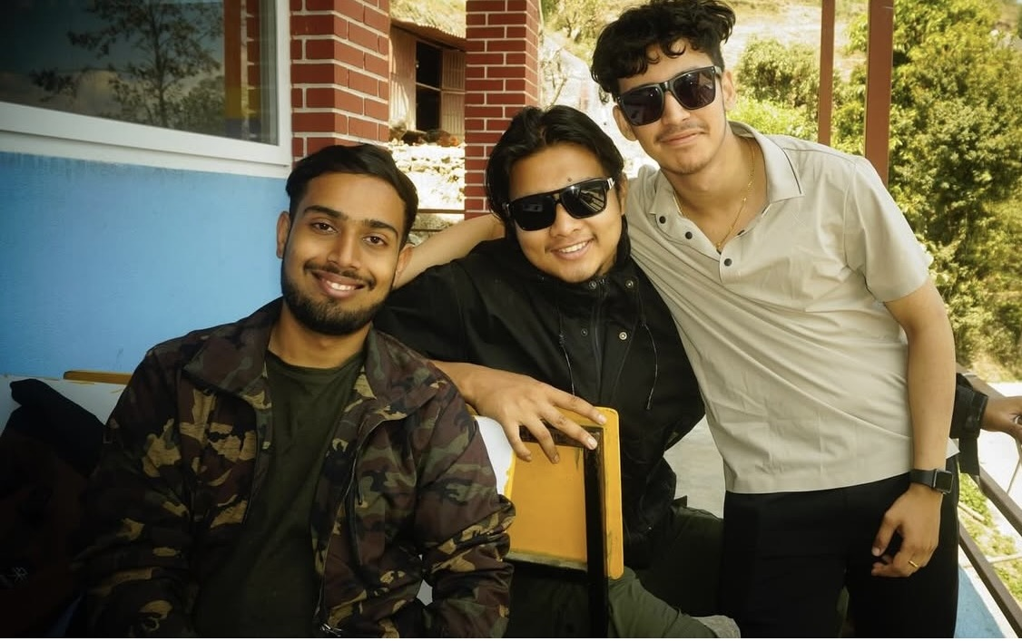
Group Contributions
We worked on this project with equal effort through in person sessions and Google Meet discussions.The project was assigned to us 14 days ago, but we began actively working on it after 5 days.
From that point, we maintained consistent coordination and completed the entire system with equal contributions from all group members.
Each member participated in writing code, testing features, collecting screenshots, and preparing documentation.
"Together, we made it happen!”

Slide 7
.
Conclusion
This Project helped us learn about building a complete Application in Python that includes real world logic as well as Modular Programming.
This project helped us enhance skills in:
1.File handling
2.Object-oriented programming
3.Inter-team collaboration and version control
Overall it was a good learning experience and it taught us how to structure an application in a deadline when you have to go from planning, to designs, to coding, to testing just to name a few.
We practiced efficiently allocating tasks, collaborating as a team, and troubleshooting , which gave us a touch of real world experience.
.
.
.

